Slide 1
Visualization of Phase and Group Velocity
:
By: Neha Binny
SC19B090

Slide 2
Create a GUI based animation to create a visualization of following cases
i) Phase velocity = Group velocity
ii) Phase velocity > Group velocity
iii) Group velocity > Phase velocity
iv) Non-zero phase velocity, zero group velocity
v) Zero phase velocity, non-zero group velocity
vi) Phase velocity = -Group velocity

Slide 3
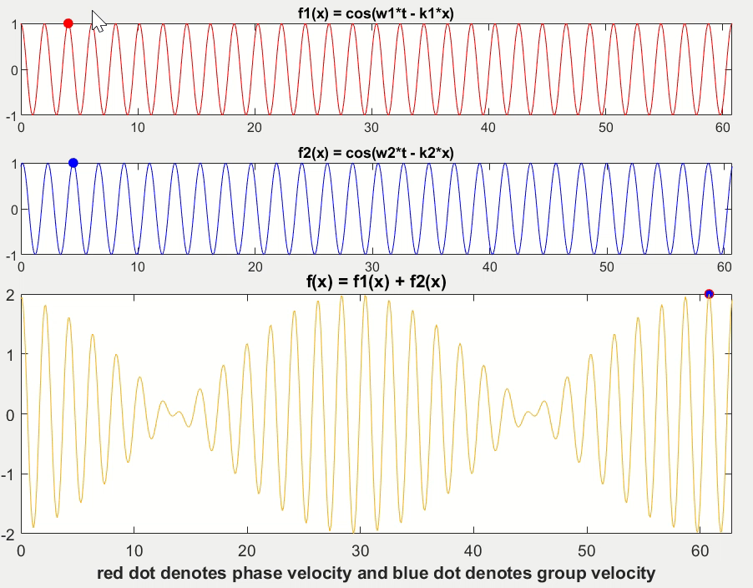
Case i: Phase velocity = Group velocity

Slide 4
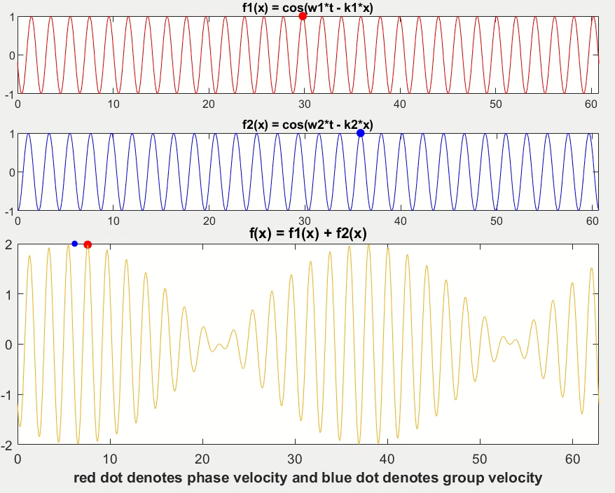
Case ii: Phase velocity > Group velocity

Slide 5
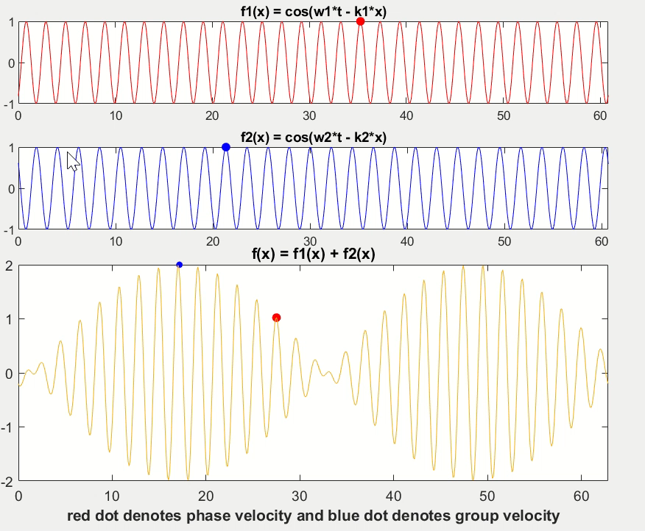
Case iii: Group velocity > Phase velocity

Slide 6
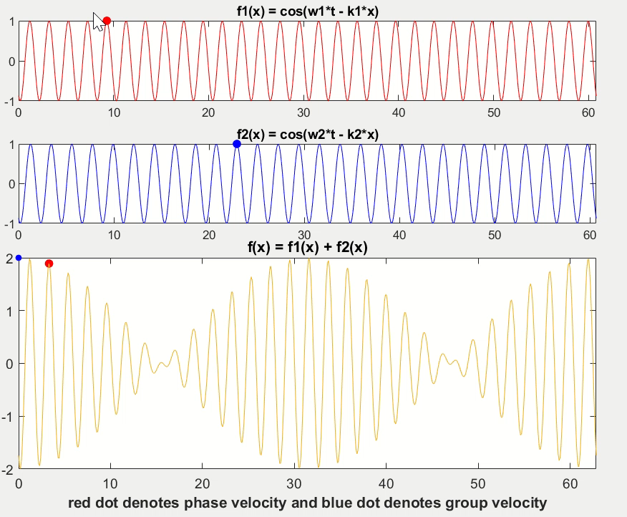
Case iv: Non-zero Phase velocity, Zero Group velocity

Slide 7
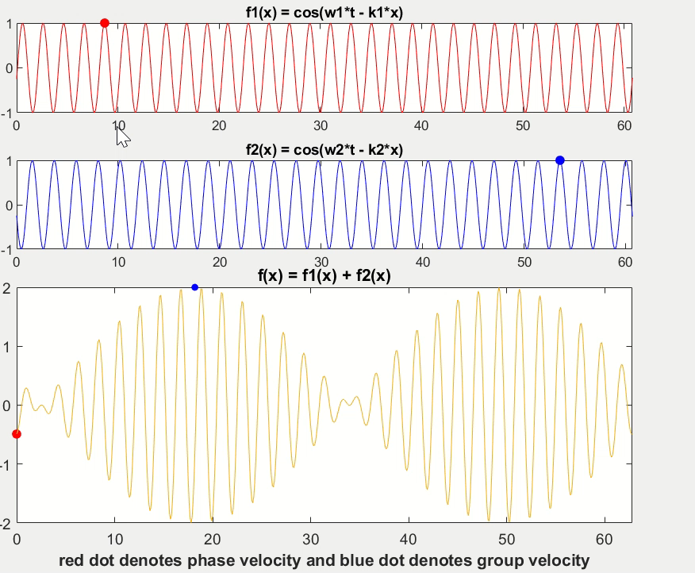
Case v: Zero phase velocity, Non-zero Group velocity

Slide 8
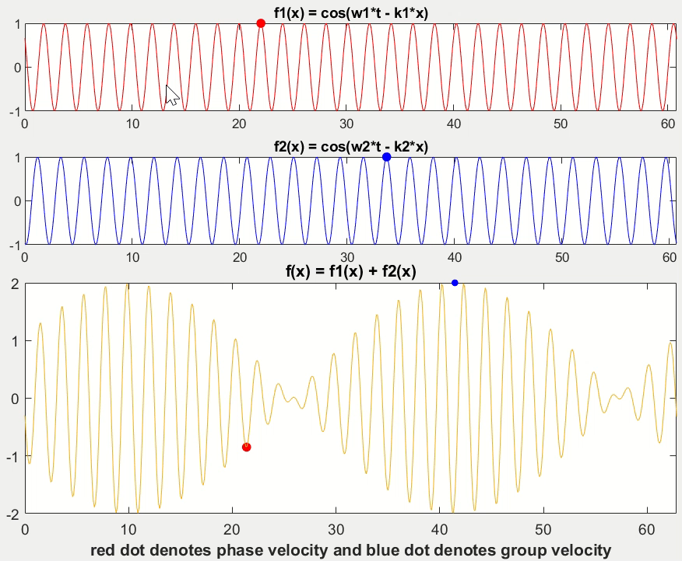
Case vi: Phase velocity = -Group velocity

